Slide 1
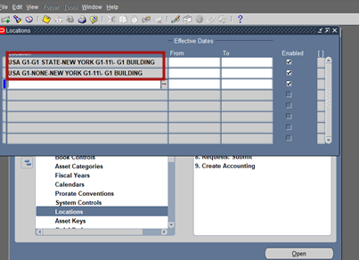
Last step

Slide 2
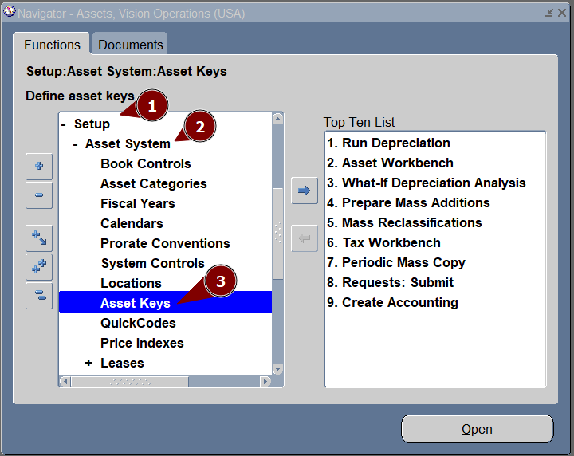
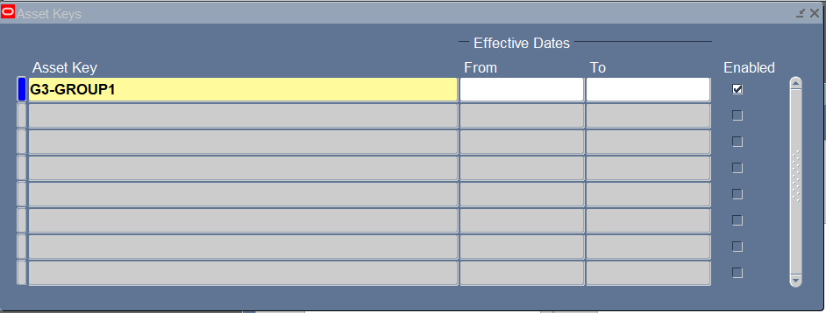
9.asset key combination
Click on asset key
Enter asset key

Slide 3
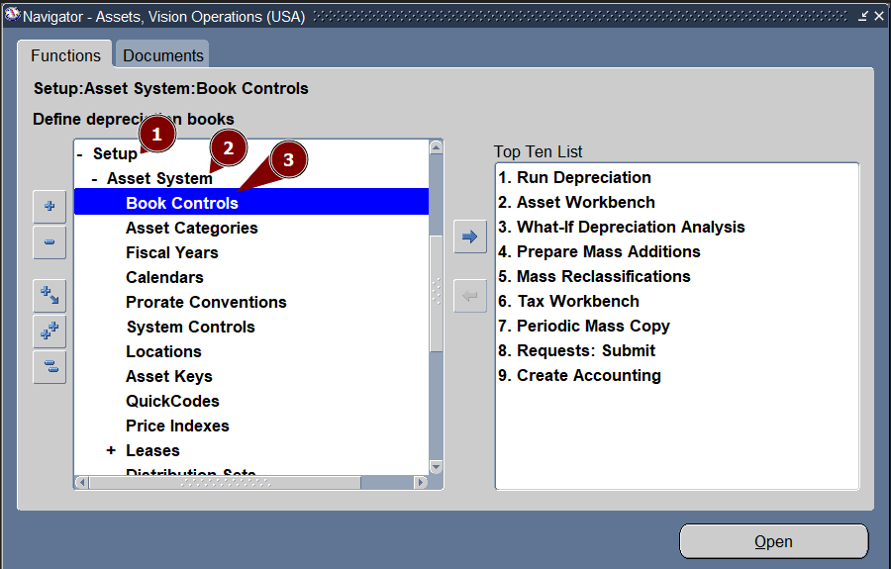
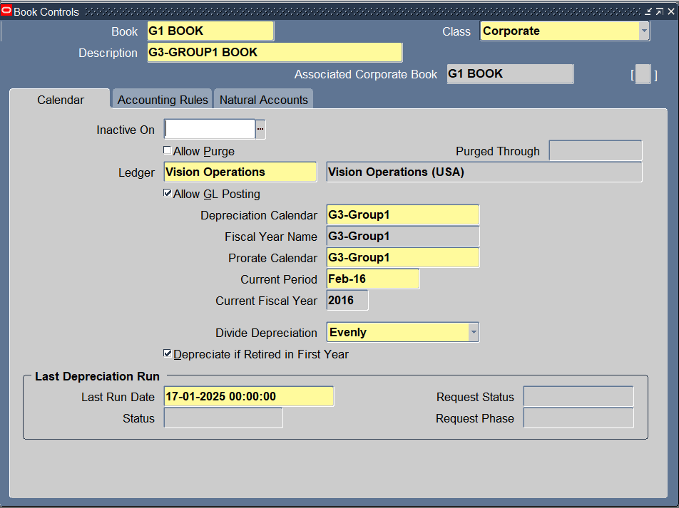
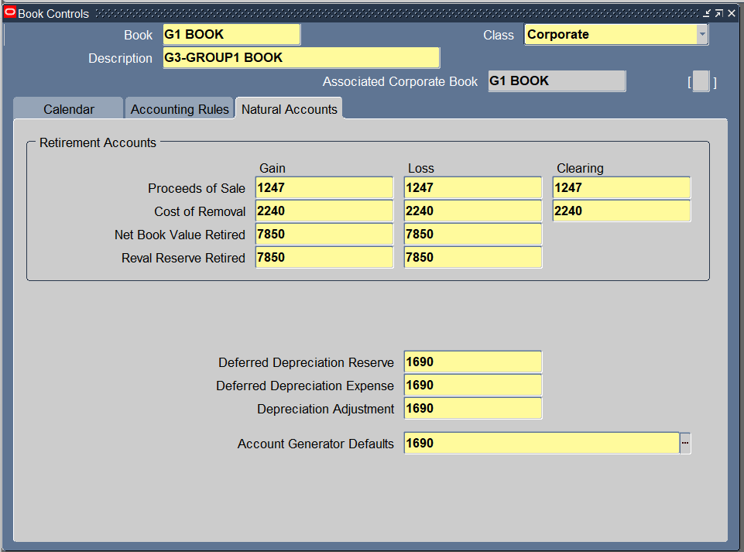
10. Create Book

Slide 4
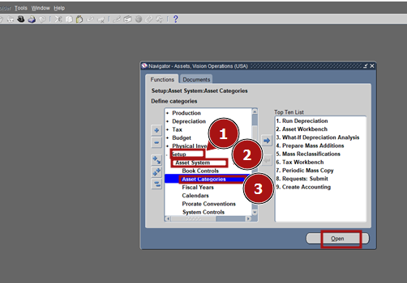
click setup – asset system – asset category

Slide 5
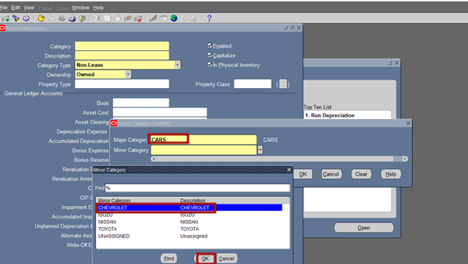
11. Category ( major: cars and minors: Chevrolet )

Slide 6
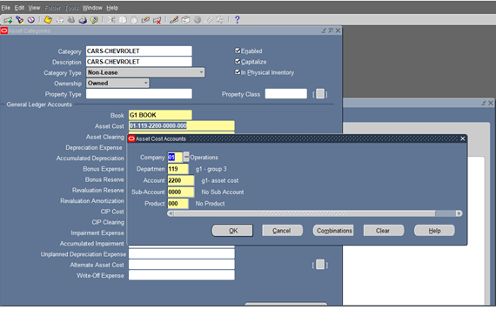
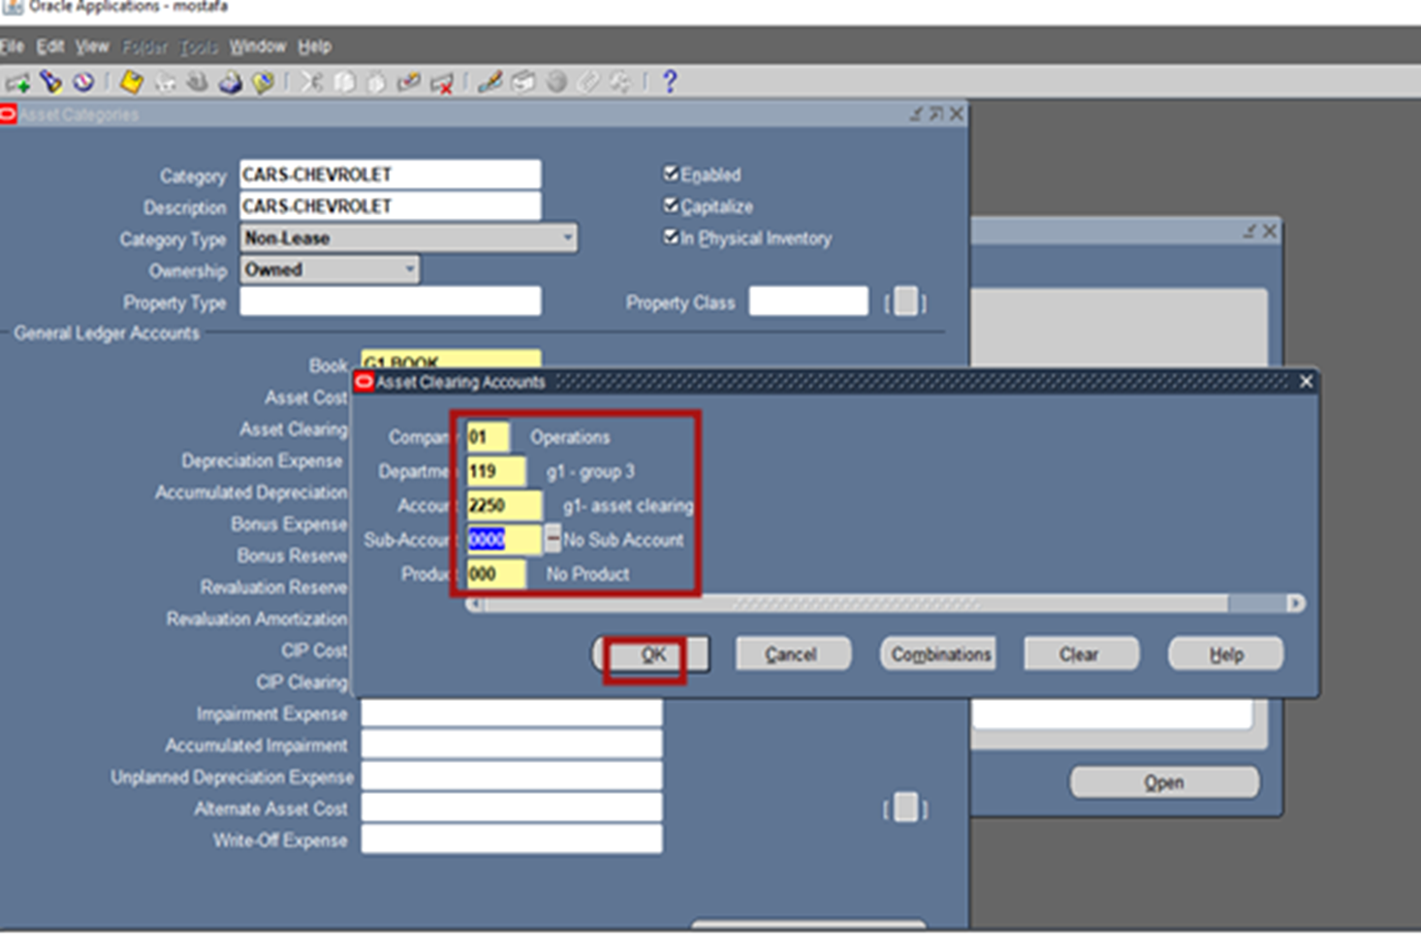
Enter accounts for cars- Chevrolet

Slide 7
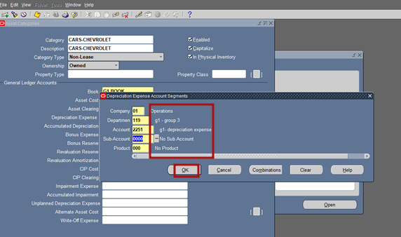
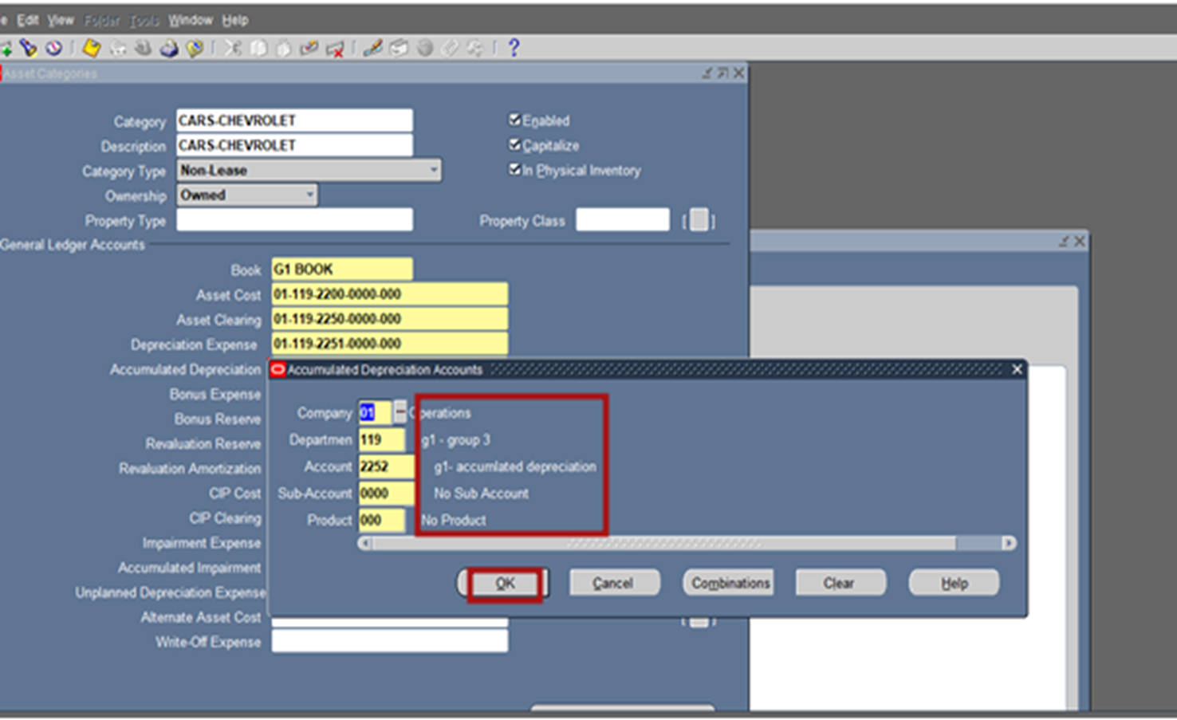
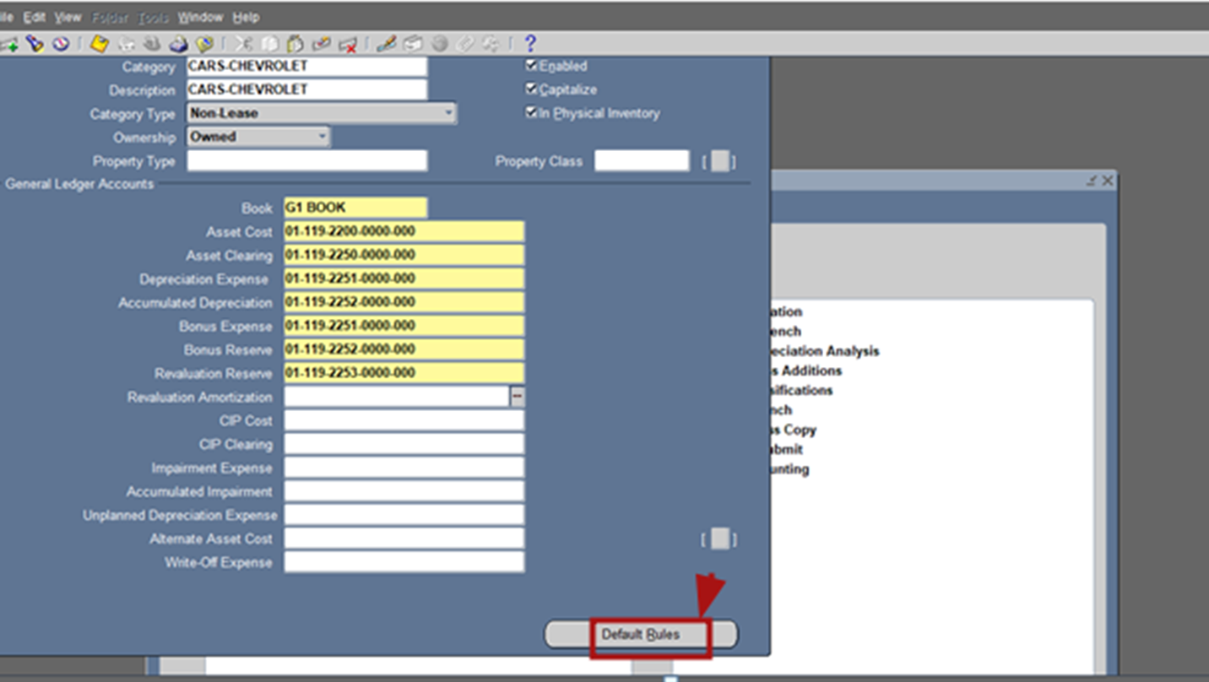
Last step: press default rules
In order to create depreciation method

Slide 8
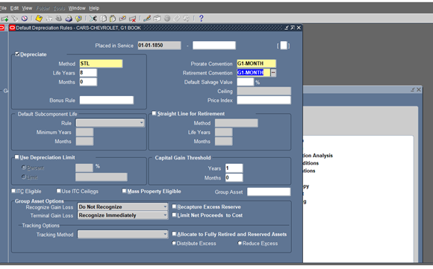
After choose our depreciation method, we press save
We repeat all the previous steps for air conditions & another car too as we shown in the next slides

Slide 9
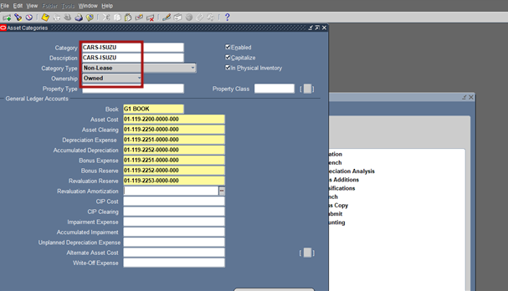
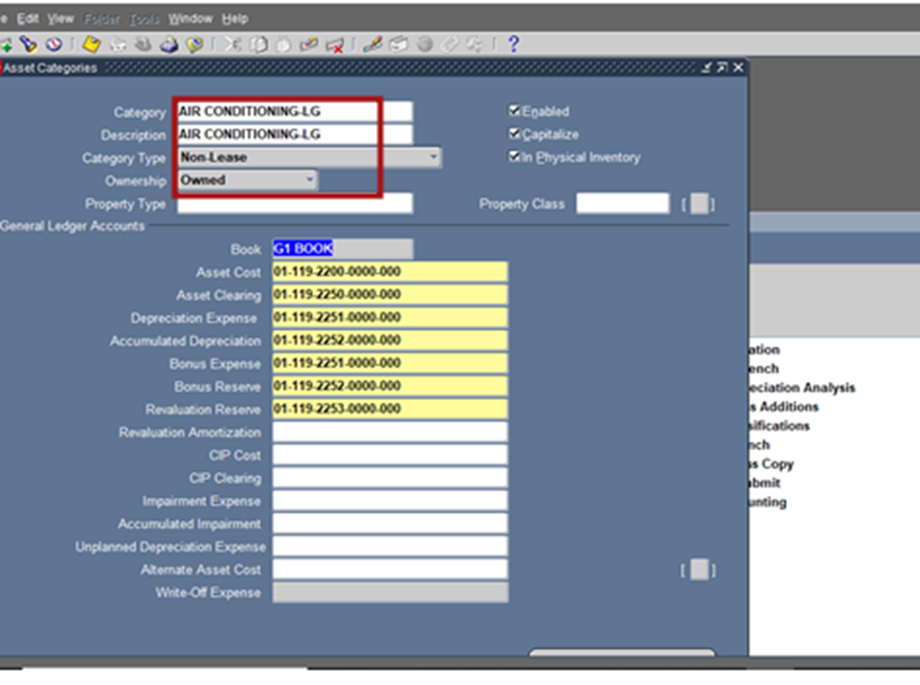
Enter accounts for cars- Isuzu
Enter accounts for air conditioning- lg

Slide 10
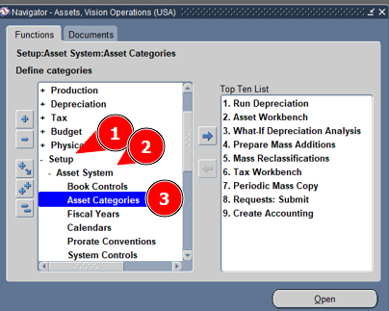
Category for depreciation method
Specify depreciation method & accounts

Slide 11
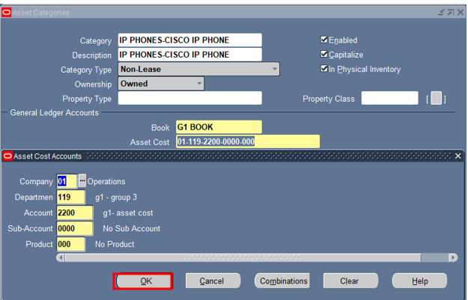
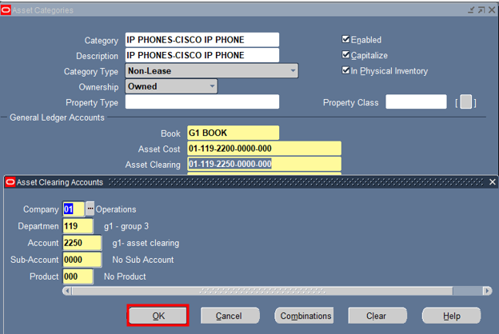
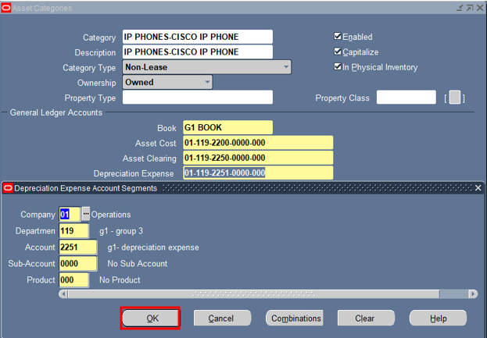
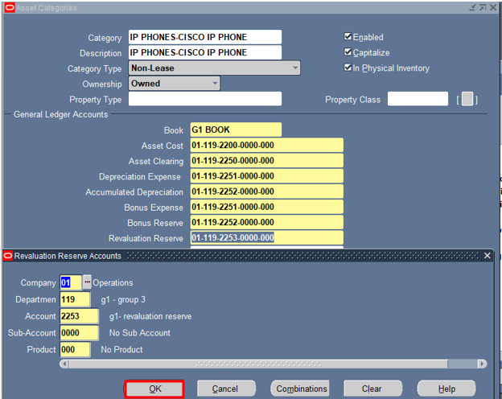
Screenshots for the step

Slide 12
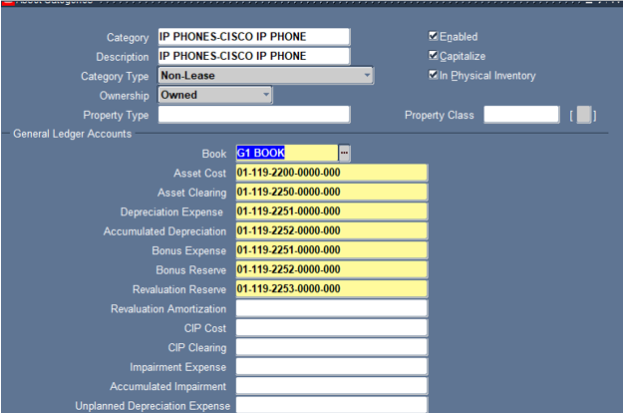
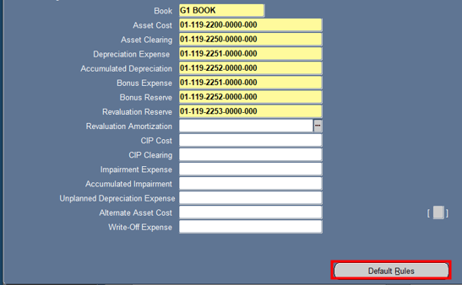
Press default rules

Slide 13
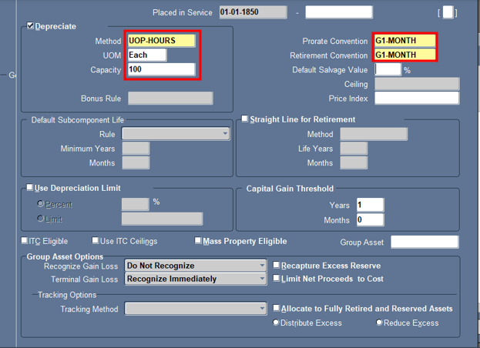
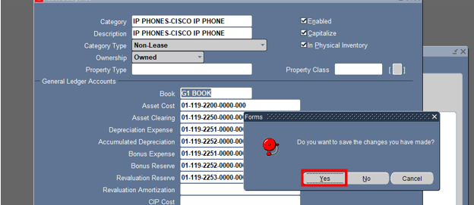
After this step press save icon in the tool bar
Now press yes to save all steps and finished the depreciation method

Slide 14
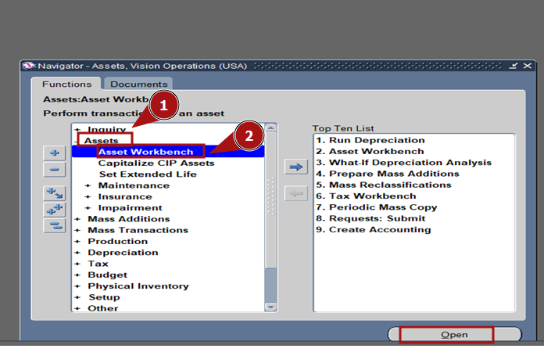
12. Addition go to asset – asset workbench click addition to enter asset details

Slide 15
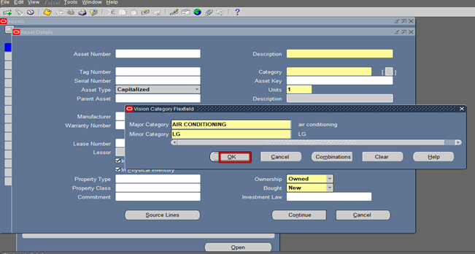
Fill in description (electronic), category (air conditioning – LG),tag number (123456), serial number (123456)

Slide 16
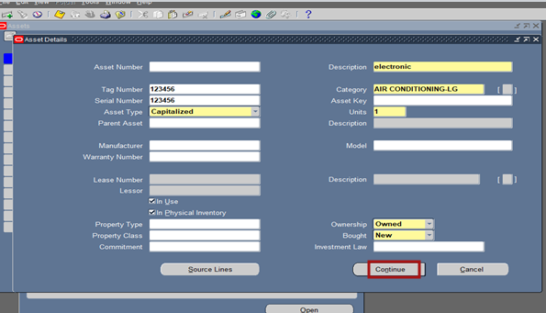
Press Continue

Slide 17
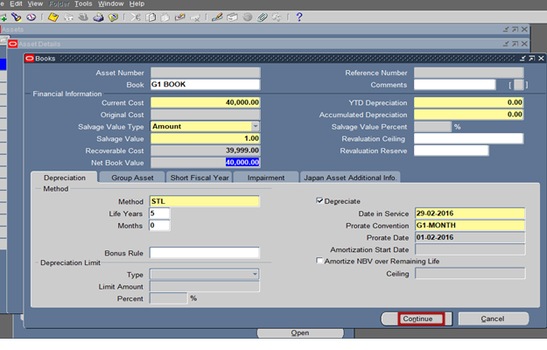
Press continue
Enter cost , date in service and salvage value

Slide 18
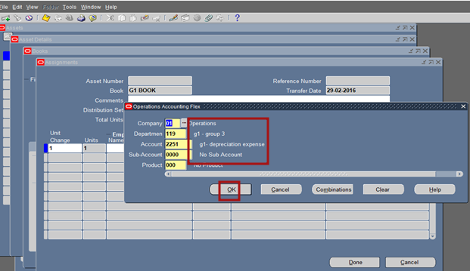
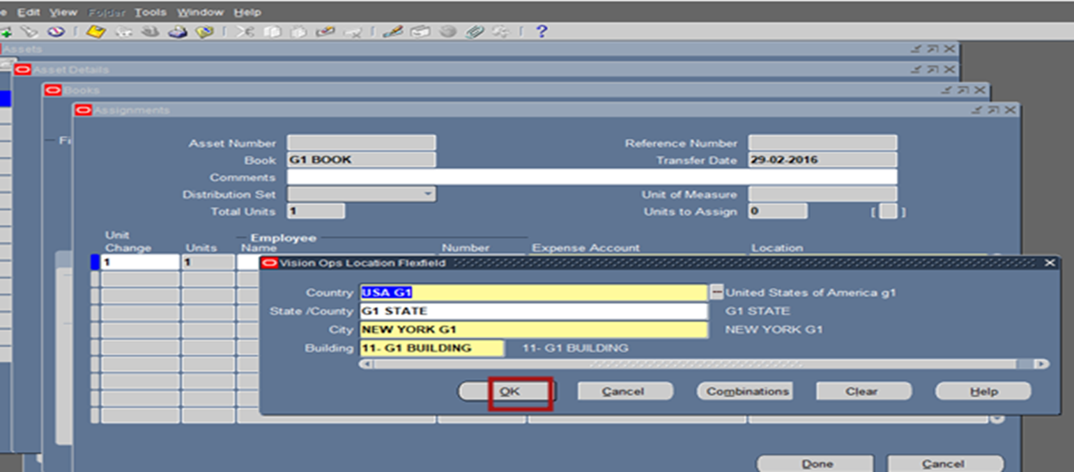
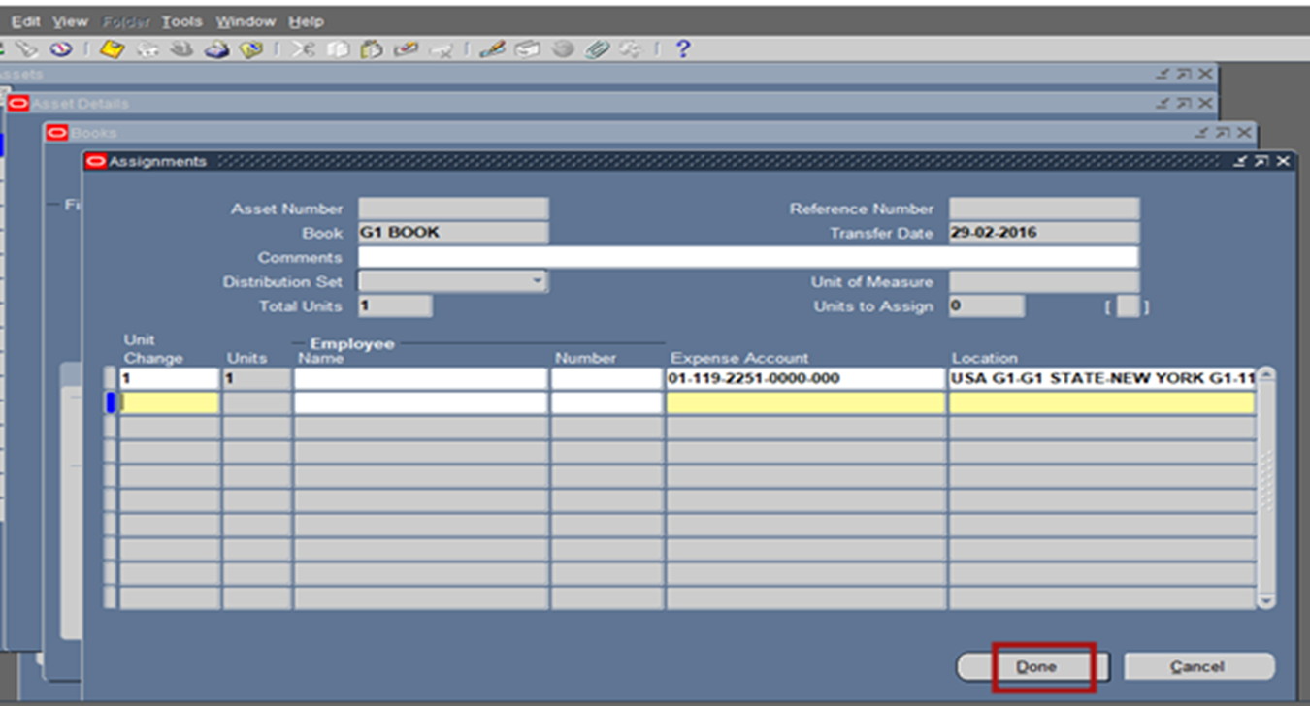
Last step for addition

Slide 19
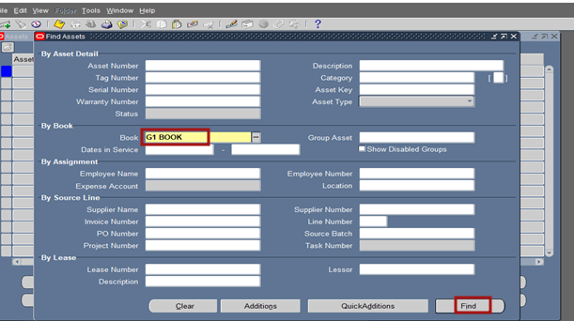
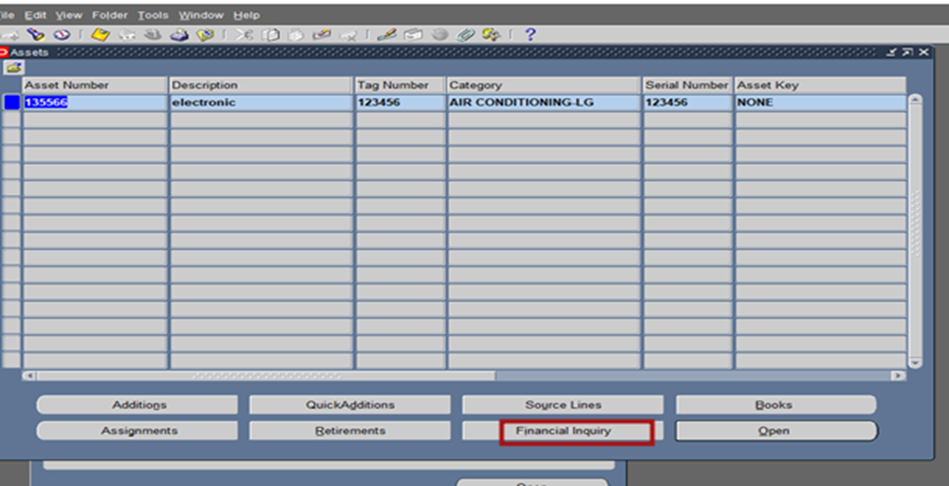
Search on asset by book ( g1 book) go to assets – asset work bench

Slide 20
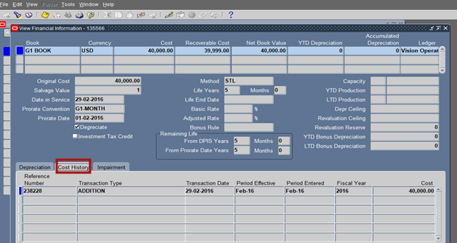
Final results for addition process

Slide 21
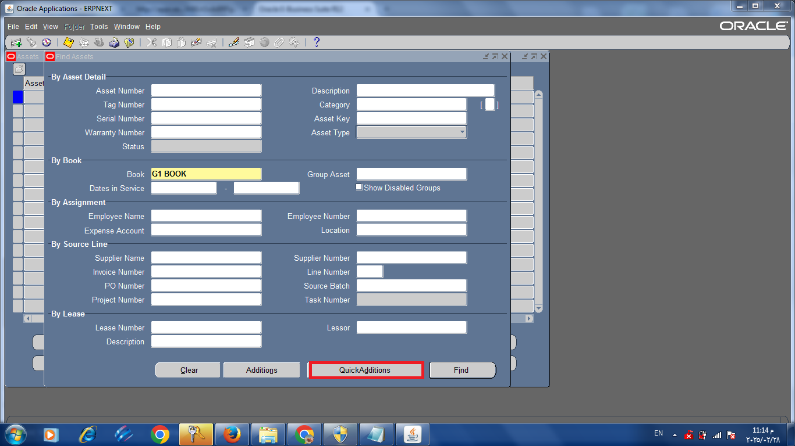
13.Quick Addition method first : Open Oracle Assets and go to Assets → Asset Workbench. Select Quick Additions Click "Quick Additions" to enter asset details

Slide 22
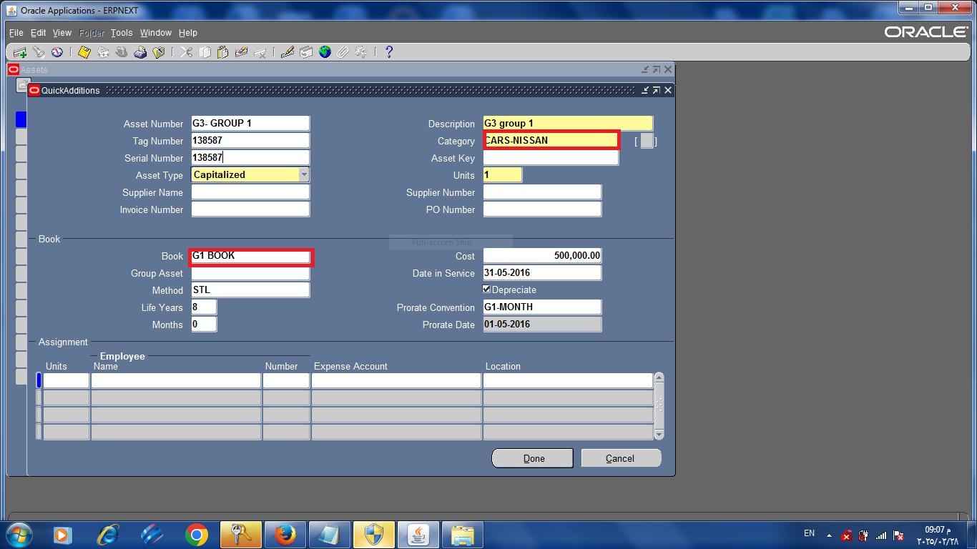
Fill in Asset Number, Description (G3- group 1 ) , Category (car – NISSAN), and Date Placed in Service.

Slide 23
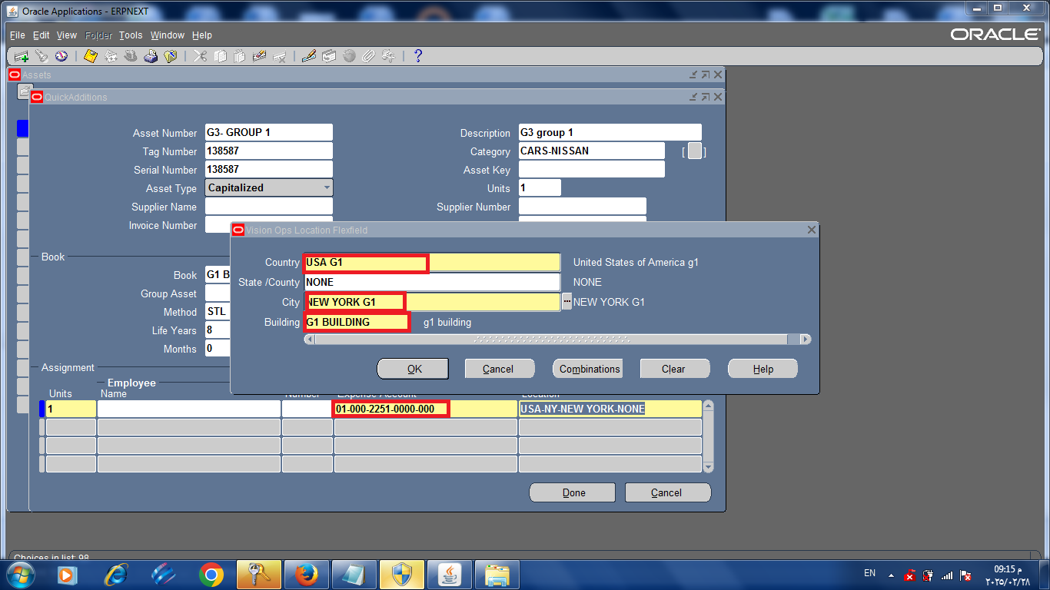
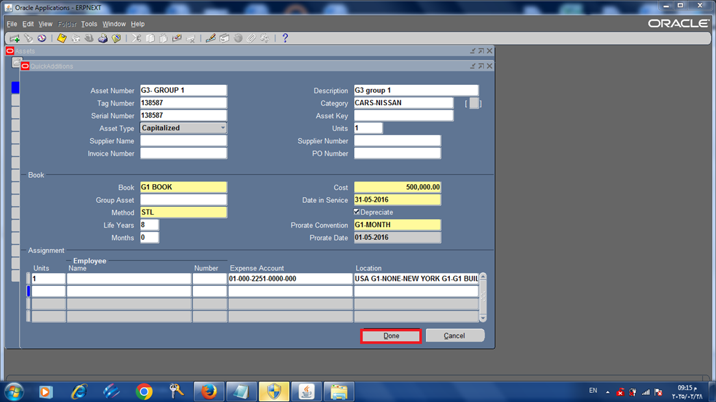
then Enter Cost, Location, and Employee Assignment
click done to Save the Asset

Slide 24
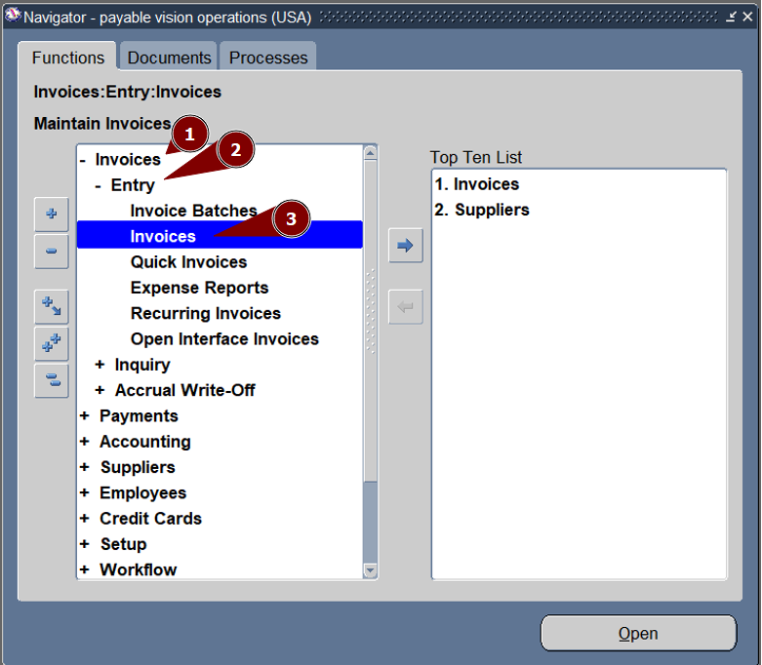
14. assets from payables

Slide 25
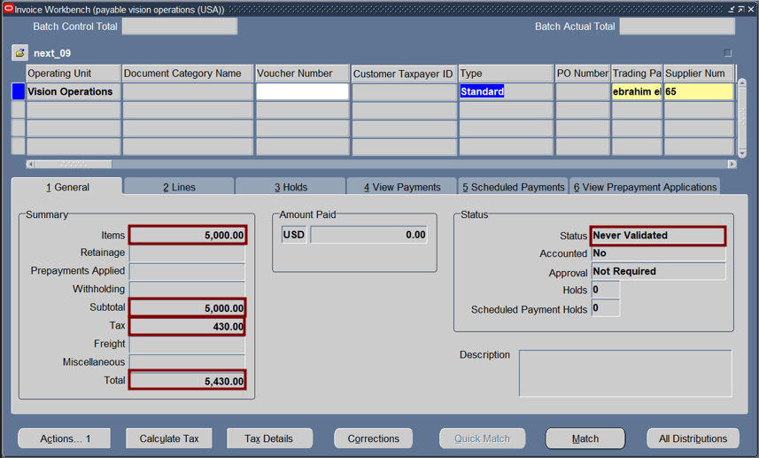
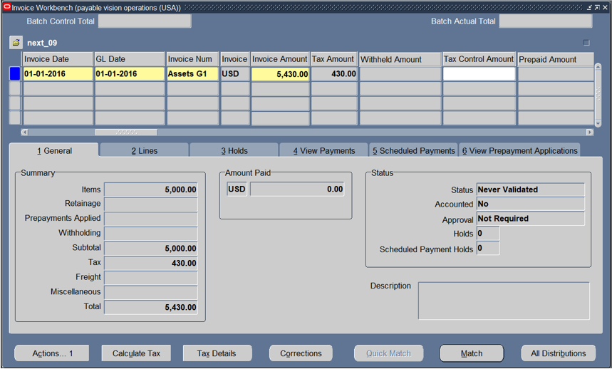
Enter supplier number, Invoice date, GL date, invoice number and invoice amount in the header.

Slide 26
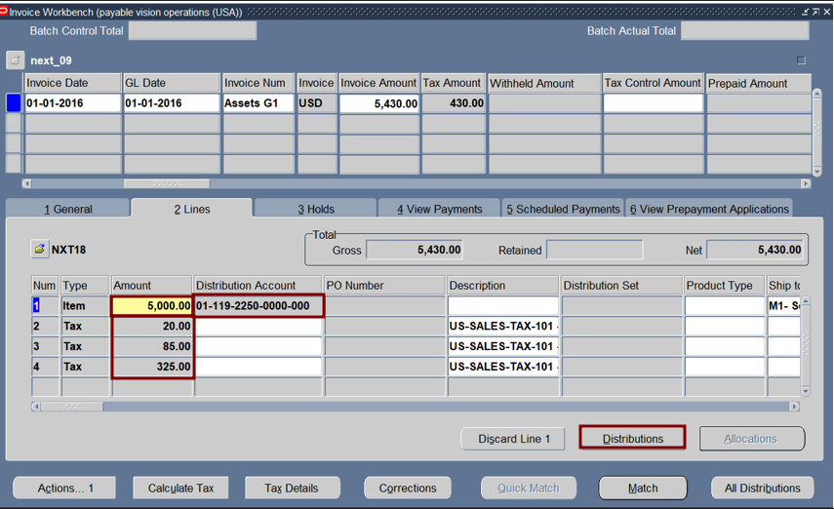
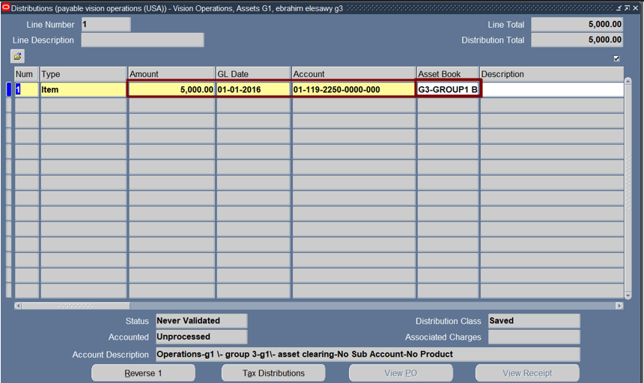
Press on distribution to enter amount, GL date, account and asset book.

Slide 27
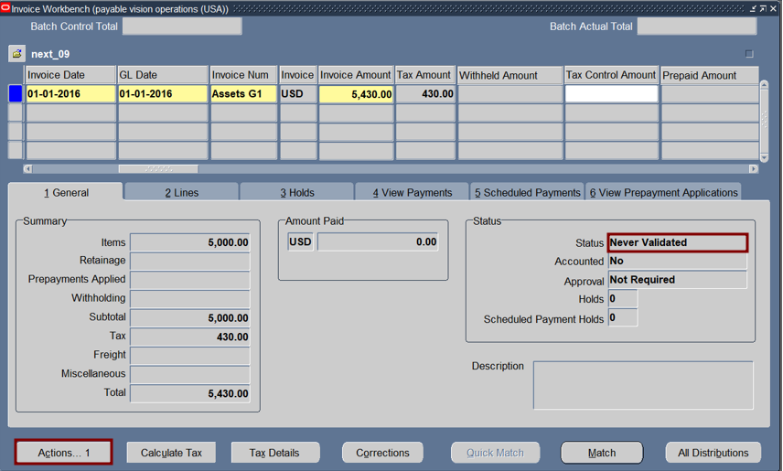
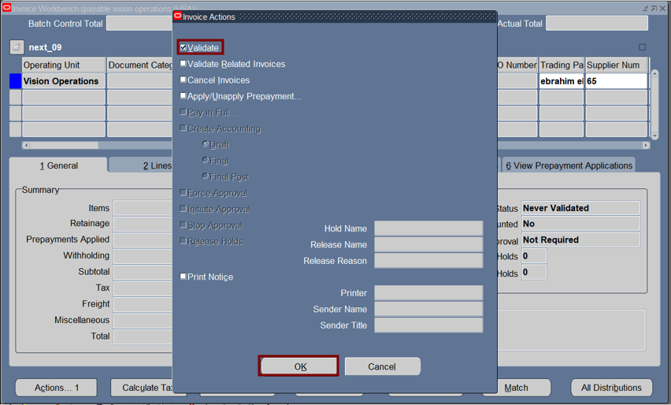
Press on actions
Choose validate

Slide 28
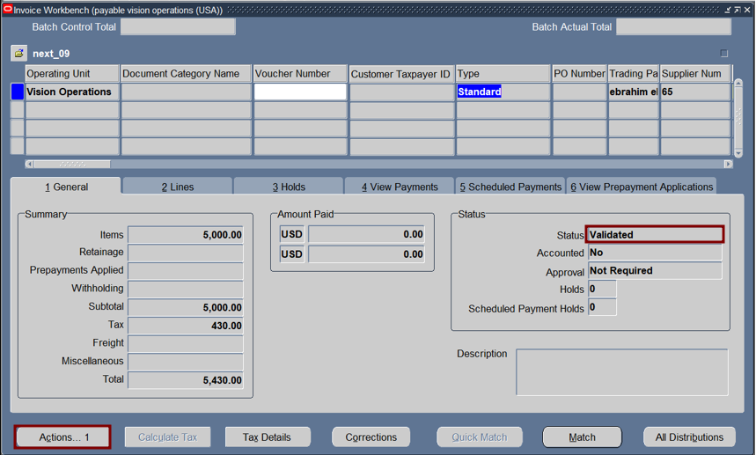
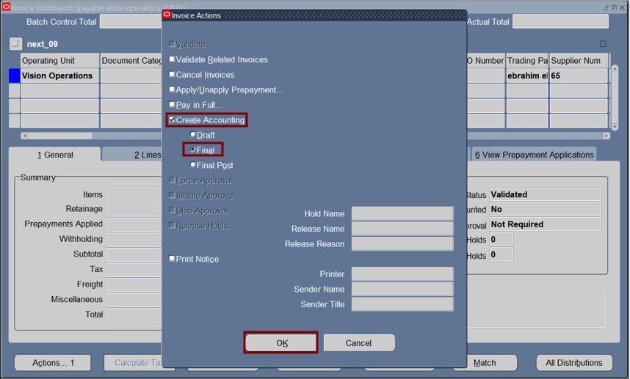
Now invoice becoming validated.
Press actions to create accounting.

Slide 29
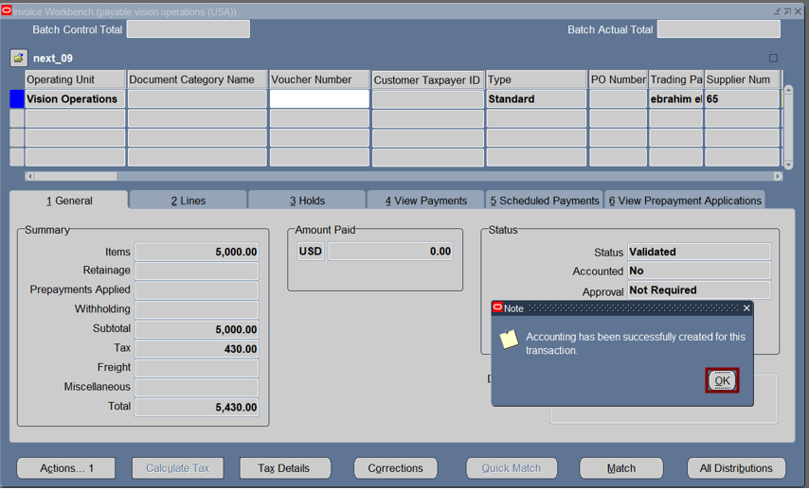
The invoice has been completed

Slide 30
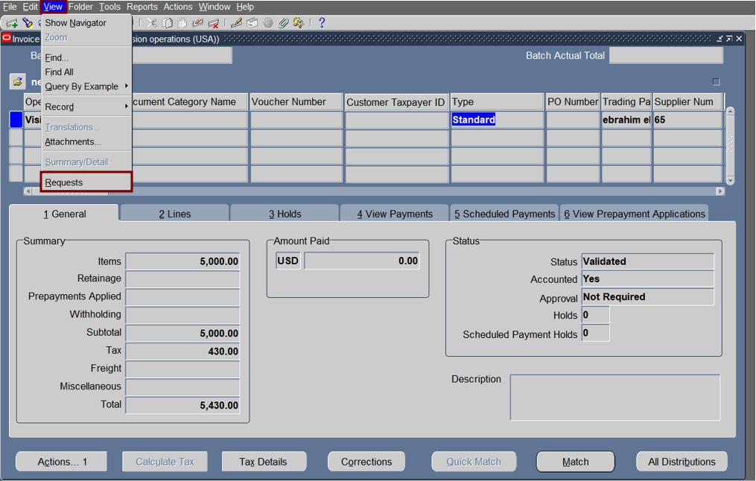

Run mass addition's report.
Press on submit a new request

Slide 31


Choose the name of request and Enter parameters.

Slide 32

Ensure that the request has been done correctly.

Slide 33

Open assets vision operations.

Slide 34


Run prepare mass addition’s request.
Press on submit a new request

Slide 35

Choose prepare mass addition and book.

Slide 36

Find a prepare mass addition request.

Slide 37

Ensure that the request has been done correctly.

Slide 38



Press on prepare mass additions and choose the asset.

Slide 39


Asset Details
source

Slide 40


Run a request to make mass addition posted.

Slide 41

Search for a request.

Slide 42

Ensure that the request has been done correctly.

Slide 43


Press on prepare mass additions
Choose cars-chevrolet

Slide 44

Ensure that posted.

Slide 45



Search for asset

Slide 46


Information about asset.

Slide 47



15. production
Add an asset in order to make production

Slide 48




Steps to add the asset

Slide 49



Now specify the account
finished

Slide 50

Beginning production

Slide 51


After identifying book press new
Use the asset we add before

Slide 52


Run the Depreciation
Depreciation → Run Depreciation.
Choose the asset book (G1 Group). Set the Depreciation Period

Slide 53


View depreciation’s request.

Slide 54

Ensure the depreciation request has been done correctly.

Slide 55

Create accounting.

Slide 56


Enter parameters (book, ledger, end date and report).
Press on submit to run the request

Slide 57

Ensure create accounting request has been done correctly.

Slide 58


Submit a new request for transfer journal entries to GL.

Slide 59


Enter parameters book, ledger and end date.
Press on options to change format.

Slide 60

Change format to excel.

Slide 61

Ensure transfer journal has been done correctly.

Slide 62

to Partially Retire an Asset Go to Assets → Asset Workbench Click Find to locate the asset

Slide 63

Select the asset from the list. Click Retirements to open the Retirement Details window

Slide 64

In the Retirement Type field, select Destroyed. Enter the Retirement Date In the Cost Retired field, enter the amount you want to retire.(100000) Click Done to save the partial retirement.

Slide 65


View the effect of retirement on asset
Click on asset workbench
Choose G1book

Slide 66


Choose asset click on financial inquiry
Asset cost changed from 500,000 to 400,000

Slide 67


To do assignments for asset.
Click on asset workbench
Choose G1book

Slide 68


Choose asset then click on assignment
enter -1 and add a new line.

Slide 69


Change account from 2251 to 6504.
Change location.

Slide 70


Click on done

Slide 71
To do amortization for asset.
Click on asset workbench
Choose G1book

Slide 72


Click on books.
Enter book.

Slide 73


Click on amortize adjustment.
Choose type of deprecation (amount) and enter limit amount.

Slide 74

Amortization has been done.

Slide 75

Adjustment 1- Change life years
Go to asset – asset work bench

Slide 76

Click find

Slide 77

Click books

Slide 78

Change life year from 5 to 8

Slide 79

Click done

Slide 80

Go to asset – asset work bench search by book (G1book)

Slide 81

Click find

Slide 82

Click financial inquiry

Slide 83


Slide 84

2- Change cost go to assets – asset workbench search by book ( g1 book)

Slide 85

Change current cost from 35000 to 38000

Slide 86

Click done

Slide 87

go to assets – asset workbench search by book ( g1 book)

Slide 88


Slide 89
Mass Transactions
Transfers
Changes
Reclassifications
Revaluations

Slide 90

Transfers : Open Oracle Assets and then Asset workbench. Select Mass Transactions then click Transfers.

Slide 91

Write the book : G1BOOK

Slide 92

Add the category ( Air conditioning – LG)

Slide 93

Add the current information Add the changes. Then click preview

Slide 94

Apparently the preview has been completed

Slide 95


Slide 96

The transaction has been completed

Slide 97


Slide 98


Open Assets Asset workbench Write the book(G1BOOK) Click Find

Slide 99

Click Assignments

Slide 100

The Expense account has already transferred

Slide 101


Open Assets Asset workbench Write the book(G1BOOK) click find

Slide 102

Press Financial inquiry to view the financial information

Slide 103

Life Years Before

Slide 104

Changes : Assets then Assets workbench , select Mass Transactions Click changes

Slide 105

Add the Asset book (G1BOOK) and the category ( AIR CONDITIONING – SHARP) Enter the before and after data (Depreciation Method ) and ( Life years) click preview

Slide 106

Click Ok to preview

Slide 107

The preview has been completed

Slide 108


Slide 109

To complete the transaction click Run The transaction is completed

Slide 110


Slide 111

Open Assets Asset workbench Write the book(G1BOOK) click find

Slide 112
Press Financial inquiry to view the financial information

Slide 113

Before changes

Slide 114

After changes

Slide 115

Reclassifications Reclassify Assets to a new Category Assets then Assets workbench , select Mass Transactions Click Reclassifications

Slide 116


The category before reclassification

Slide 117

Add the Asset Book (G1BOOK) , The category (AIR CONDITIONING-UNIONAIRE) and The new category (AIR CONDITIONING- SHARP)

Slide 118

Click preview to show the request

Slide 119

The preview has been completed To finalize click Run

Slide 120

Revaluations: From the Asset workbench ,open the Mass Transactions select Revaluations

Slide 121


Add The Asset book (G1BOOK) choose the category (CARS-CHEVROLET) Choose the rate

Slide 122

click preview to show the request

Slide 123




The preview has been completed To finalize click Run

Slide 124

Press Financial inquiry to view the financial information

Slide 125


Slide 126

Go to general ledger to review gornal

Slide 127

Click journal - enter

Slide 128

Click find
Enter source (asset), period (feb-16)

Slide 129

Click review journal

Slide 130

Dr Cr
Asset cost 40,000
Asset clearing 40,000

Slide 131


Find asset from GL.

Slide 132

Purchase invoice has not posted.

Slide 133


Press on post then enter period

Slide 134

Choose payable then click on post

Slide 135


Find a post request.

Slide 136

Ensure post request has been done correctly.

Slide 137


Search for purchase invoice.

Slide 138

Purchase invoice posted.
Dr
Assets Clearing
Cr
Account Payable

Slide 139


Search for asset depreciation.

Slide 140

Depreciation entry is not posted.

Slide 141

Enter line drilldown to show entries.
Dr
Depreciation expense
Cr
Accumulated depreciation

Slide 142

Enter view transaction to view more information about depreciation .

Slide 143

Amount of depreciation in may.

Slide 144


Create journal entry
Click on post.
Click on journal enter

Slide 145


Ensure post request has been done correctly.

Slide 146



Create AutoCopy from journal Entry.
Click on AutoCopy Batch.
Enter period then click on ok.

Slide 147

Ensure Auto copy request has been done correctly.

Slide 148


Make a reverse by switch Dr\Cr.

Slide 149


Search for reversed journal.
Journal has been reversed.

Slide 150


To post reversed journal
Click on post
Enter period and Batch
Click on find.

Slide 151

Enter post.

Slide 152


Make a reverse by change sign method.

Slide 153

Journal has been reversed.
Click on post.

Slide 154

Ensure request has been done correctly.

Slide 155

Change curreny
Setup
Currency
Rates
Daily.

Slide 156


Enter currencies, Date, type and value.
Click on enter by date range.

Slide 157


Finally click on apply
Change journal’s currency.

Slide 158


Post journal then ensure request has been posted.

Slide 159


Enter recurring journal.
Journal.
Define.
Recurring.
Enter journal, category, currency then lines.

Slide 160


Enter line 1 for debit account.
Enter line 2 for credit account.

Slide 161


Click on generate then submit.

Slide 162


Enter period then click on submit.
Ensure recurring request has been done correctly

Slide 163

Search for recurring journal.

Slide 164

Show recurring journal.

Slide 165


Post recurring journal.
Request has done correctly.

Slide 166


To open and close period.
Enter period then click on find.

Slide 167


Choose open or close period.

